Slide 1

Date: June 17th, 2020
G-13 UG Project Presentation Examination - 2020
ECE Department, SVNIT

Slide 2
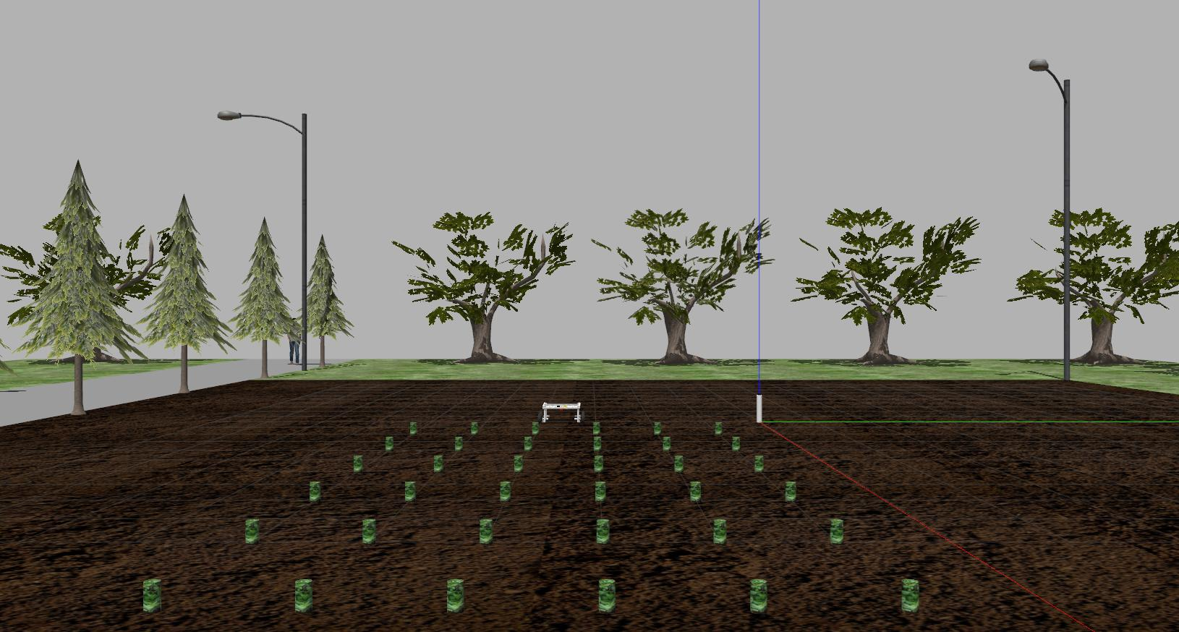
AUTONOMOUS AGRICULTURE ROBOT
“AGRIBOT”
Presented by: -
Mr. Dhruv Patel (U16EC053)
Mr. Meet Gandhi (U16EC056)
Mr. Shankaranarayanan H (U16EC074)
Guided by: -
Dr. Anand kumar D. Darji.
Associate Professor & HoD,
ECED, SVNIT, Surat-395007.

Slide 3
OUTLINE OF THE PRESENTATION
Problem Statement Explanation
Our Approach and Timeline
Modelling & Simulation
Algorithms Implementation
Results & Conclusion
Demo
Q&A.

Slide 4
PROBLEM STATEMENT EXPLANATION
Present scenario in the field of Agriculture.
Recent advances in the field of Precision farming.
What is AGRIBOT ?

Slide 5
Studying the recent advancements in the field of Precision Agriculture
2. Our Approach & Timeline
Sep 15
Planning on the basis of Problem Statement and Finalising the components required for AGRIBOT
Nov 4
UNet Model for Crop-Weed Classification + Designing the Mechanical Model using Solidworks
Nov 16
Implementation of different Algorithms for Crop-Weed Classification on various Datasets + Designing the system architecture in ROS
Modelling and Simulation of AGRIBOT using GAZEBO
Surveying the Problems faced in the Agricultural Field.
Nov 16
Apr 25
Aug 15
Manufacturing of the Mechanical Model
Prediction on images from Surrounding Farm.
Dec 13
Defining the Problem Statement for AGRIBOT
Bonnet Model for Crop-Weed Classification
Oct 3
Feb 3
May 17
2019
2020
Aug
Sep
Oct
Nov
Dec
Jan
Feb
Mar
Apr
May
2020

Slide 6
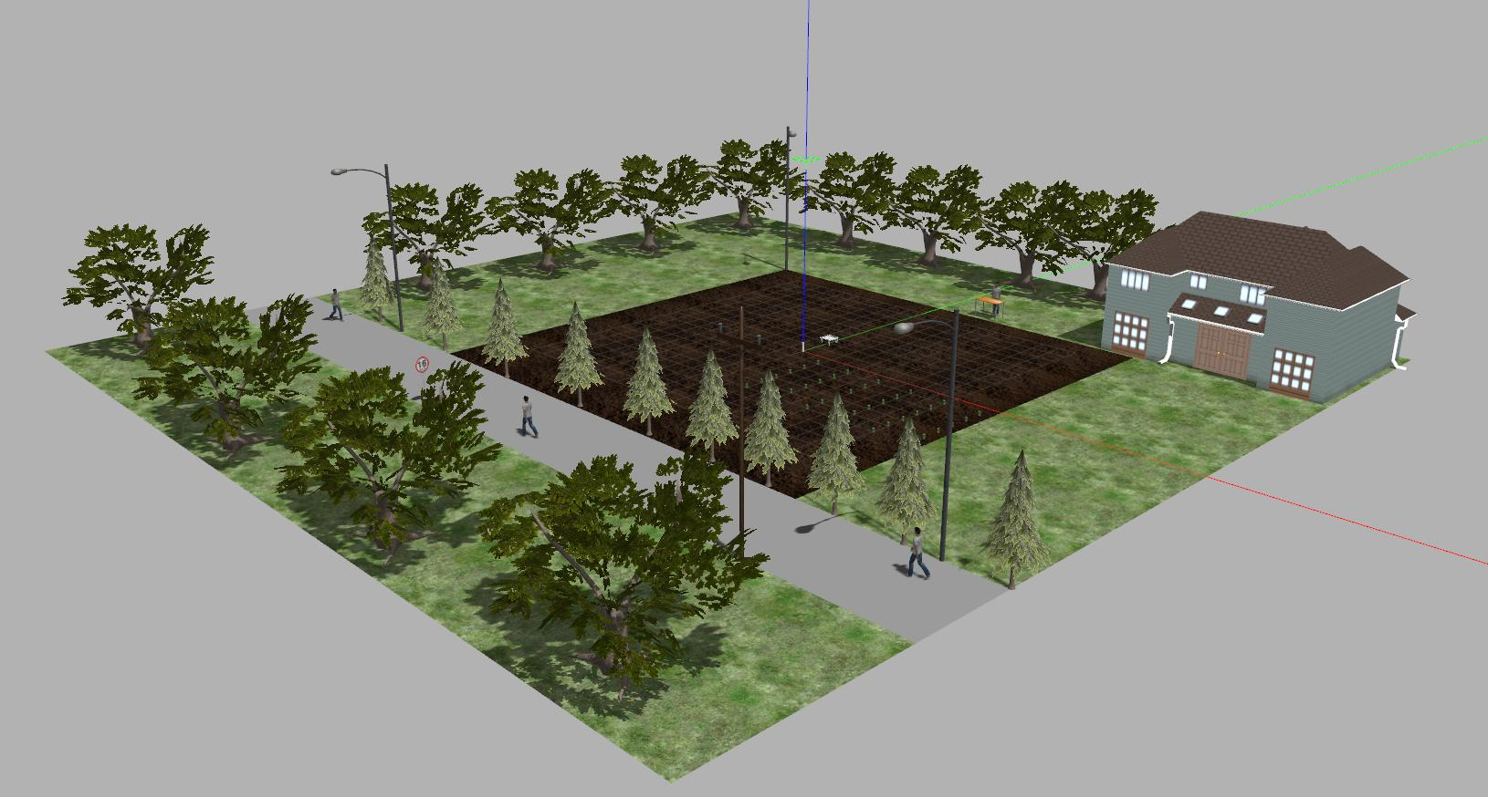
3. Modelling & Simulation
Physical model Description
World Environment model Description
Sensor & hardware Modelling

Slide 7
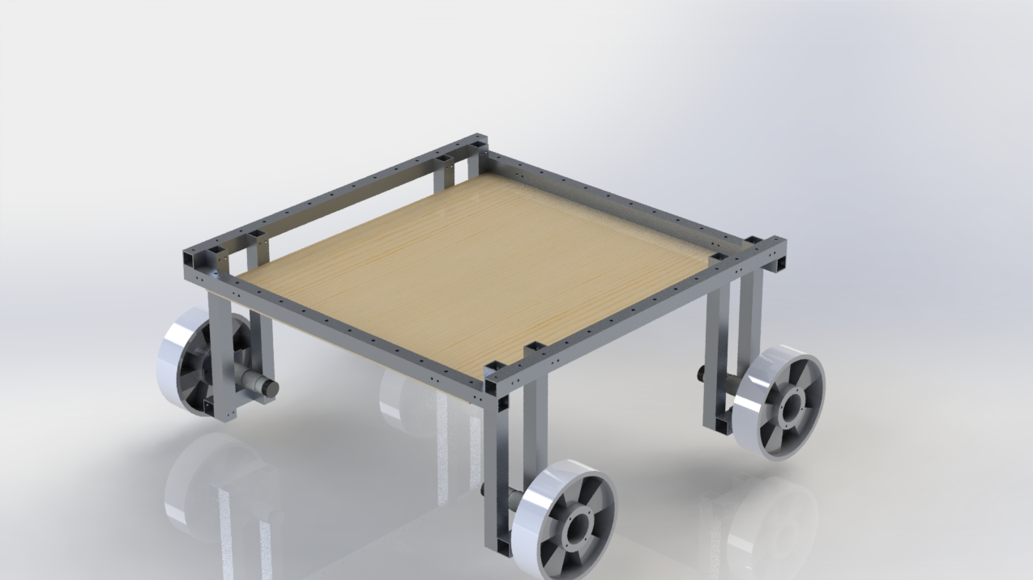
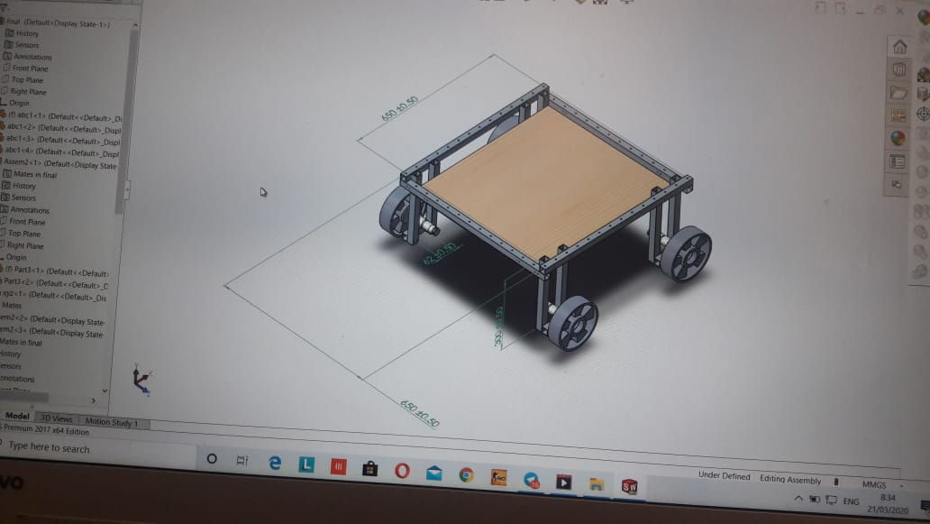
Modelling of AGRIBOT(Robotic Vehicle)
Rendered Image of model in Solidworks
Solidworks-2016 Design
Continue...

Slide 8
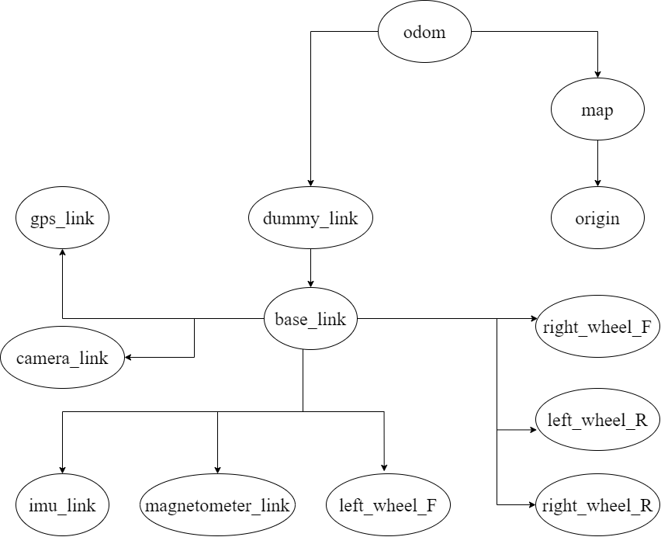
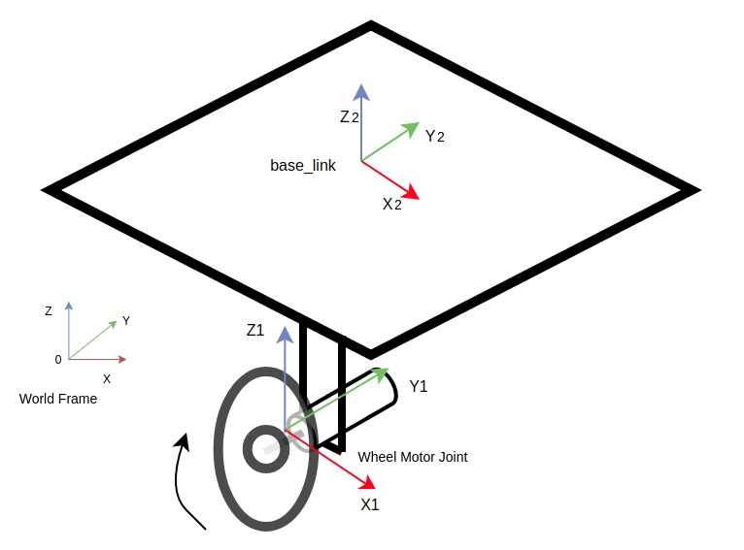
Continue slide no. 7
Kinetic Frame(Forward Kinematics & Inverse Kinematics)
TF Frame/ Coordinate Frame Transfer

Slide 9
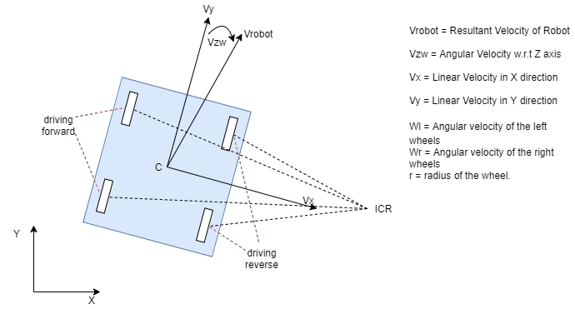
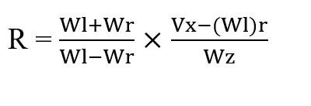
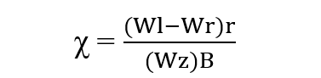
Kinematics model of Skid-Steering System. Courtesy: Wang T, Wu Y, Liang J, Han C, Chen J, Zhao Q. “Analysis and experimental kinematics of a skid-steering wheeled robot based on a laser scanner sensor” in Sensors (Basel). 2015;15(5):9681‐9702. Published 2015 Apr 24. doi:10.3390/s150509681

Slide 10
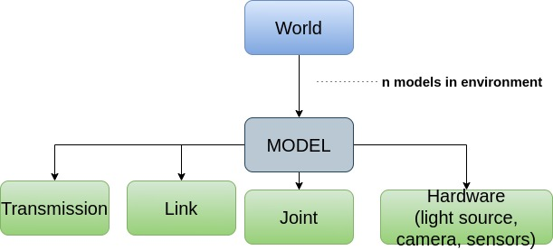
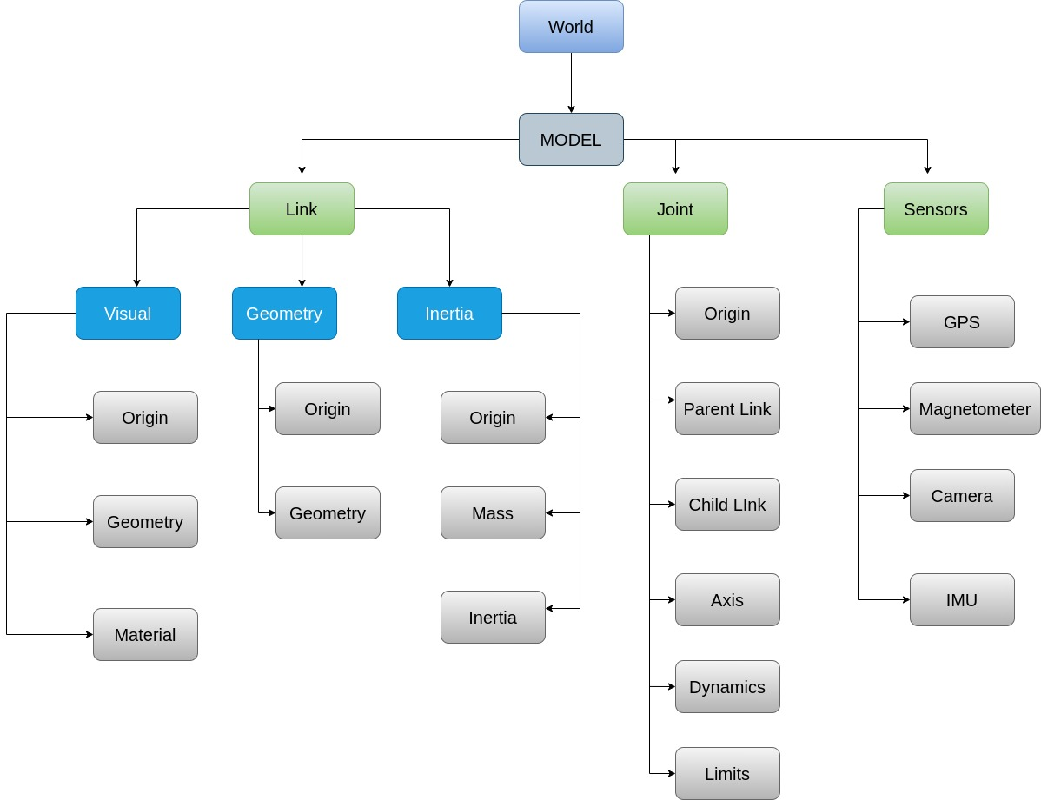
Modelling of Environment
Physical properties like gravity, luminous, wind flow, friction between soil & wheels has been added through GAZEBO API during initialization.

Slide 11
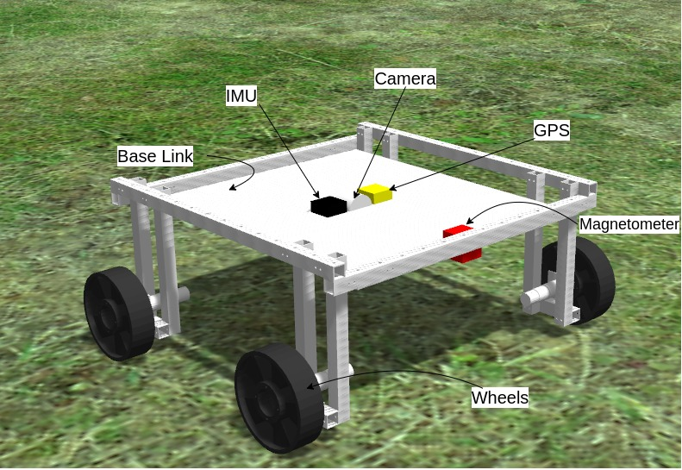
Sensor Modelling
Y = Y’+ B + N_{Y}
B’ = − B/ τ + N_{B}
Y is simulated sensor value
Y’ is raw measured value
B is bias/offset Value for sensor
N_{Y} is additive Gaussian noise
N_{B} is characteristics of random drift with time τ
Ref: Mostafa Sharifi, XiaoQi Chen, Christopher Pretty, Don Clucas, Erwan Carbon-Lunel presented “Modelling and simulation of a non-holonomic omnidirectional mobile robot for offline programming and system performance analysis” in Simulation Modelling Practice and Theory 87 (2018) 155-169 by ELSEVIER

Slide 12
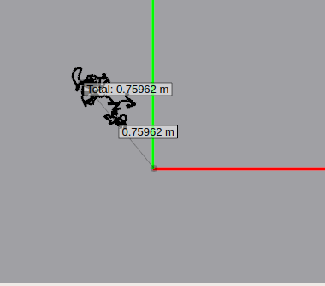
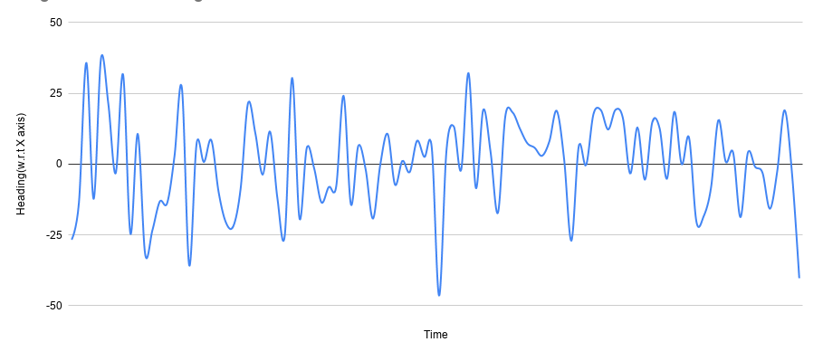
Variation in Sensor Reading at initial stationary position
GPS Reading
Magnetometer Raw Reading

Slide 13
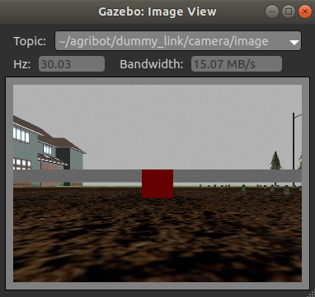
Simulation of Camera
Technical specifications:
-640 * 480 frame
-Gaussian Noise
-RGB channel

Slide 14
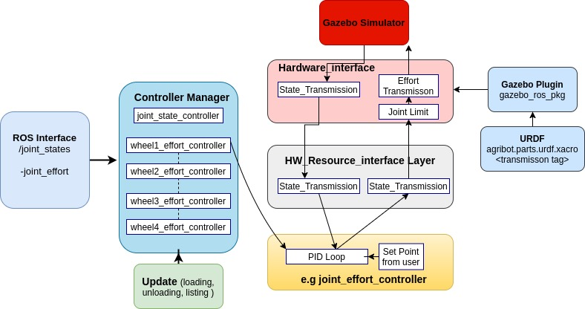
Control Plugin(Gazebo-ROS-Control)

Slide 15
4. Algorithms Implementation
Filtering and Sensor Fusion
Control and Navigation Algorithm
Crop Weed Classification Models

Slide 16
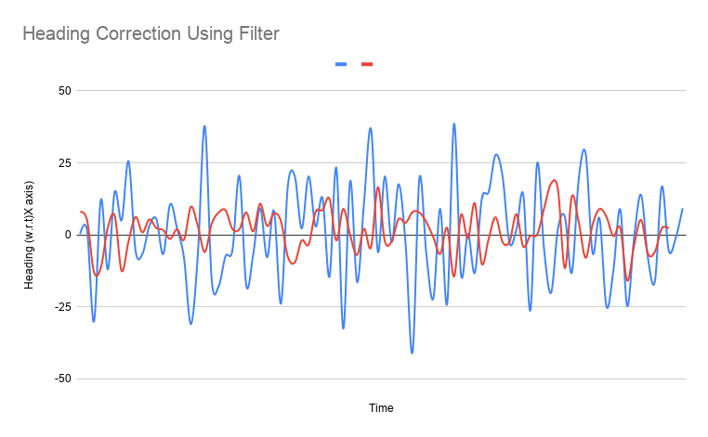
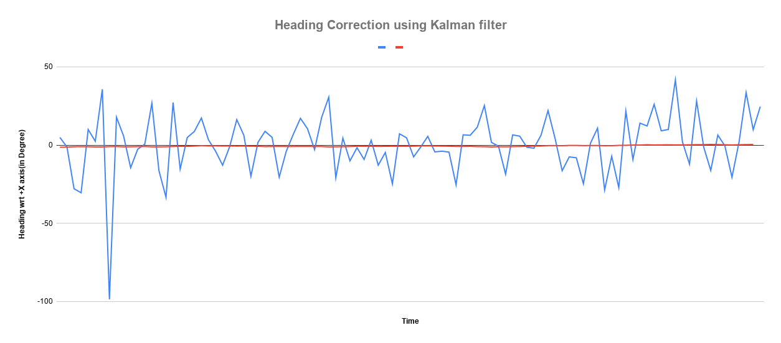
Filtering Magnetometer data
1. Moving median
2. Kalman Filter
1
2

Slide 17
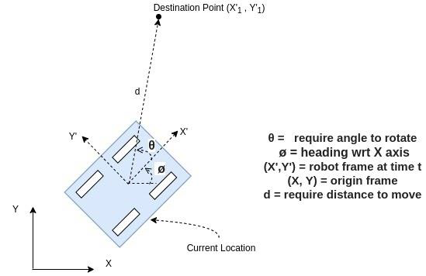
Calculation of parameters- Required angle(θ) and distance(d) to Destination
Calculation of the required angle and distance to destination.
θ = atan2 (Y'₁-Y', X'₁-X') ± ø
d = ((X′₁−𝑋′)²+(𝑌′₁−𝑌′)²)^{1/2}

Slide 18
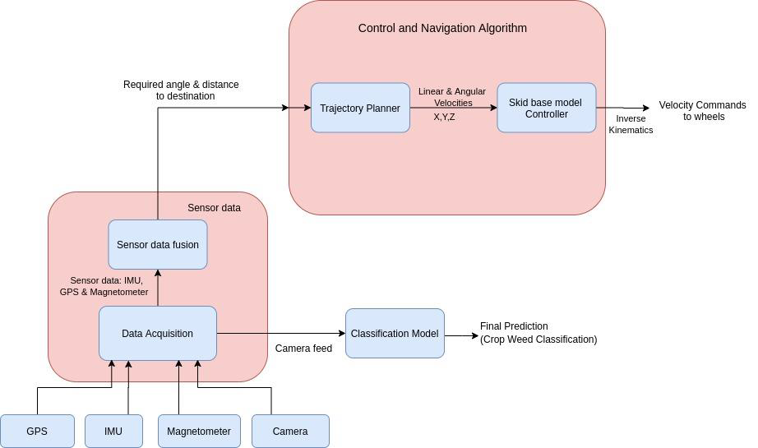
Control & Navigation Algorithm
Pictorial View of Path Planning Algorithm.

Slide 19
Crop Weed Classification
SEMANTIC SEGMENTATION MODELS
Unet
Bonnet

Slide 20
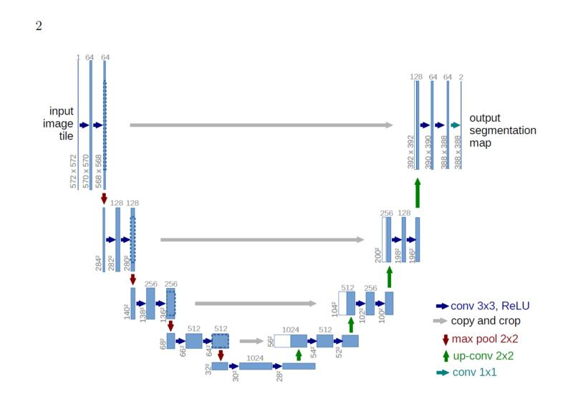
UNet Architecture
Ref: Olaf Ronneberger, Phillip Fischer, Thomas Brox, “U-Net: Convolutional Networks for Biomedical Image Segmentation”, Medical Image Computing and Computer-Assisted Intervention (MICCAI), Springer, LNCS, Vol.9351: 234--241, 2015.

Slide 21
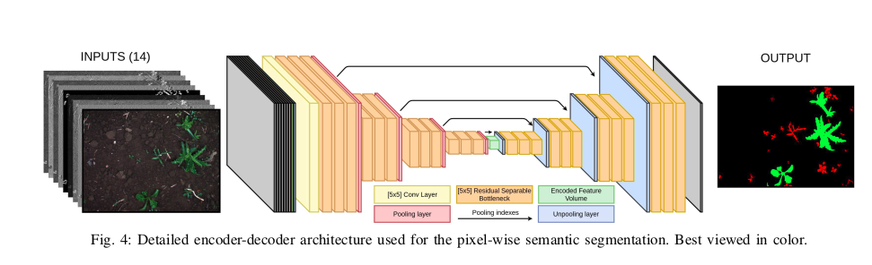
Bonnet Architecture
Ref: Andres Milioto, Philipp Lottes, Cyrill Stachniss. Real-time Semantic Segmentation of Crop and Weed for Precision Agriculture Robots Leveraging Background Knowledge in CNNs, IEEE International Conference on Robotics and Automation 2018.

Slide 22
UNET VS BONNET COMPARISON
Parameters: 23,54,785 | Parameters: 26,595
Input channels: 3 i.e. R,G,B | Input channels: 10 to increase the generalization over data and different conditions.
Decoder: UPsampling | Decoder: Uses Unpooling with shared indices which maintain spatial information
Expected to have slower classification rate | Expected to have faster classification rate than UNet
Bonnet Model is chosen as it generalizes well and has comparatively less parameters.
Bonnet Ref: Andres Milioto, Philipp Lottes, Cyrill Stachniss. Real-time Semantic Segmentation of Crop and Weed for Precision Agriculture Robots Leveraging Background Knowledge in CNNs, IEEE International Conference on Robotics and Automation 2018.

Slide 23
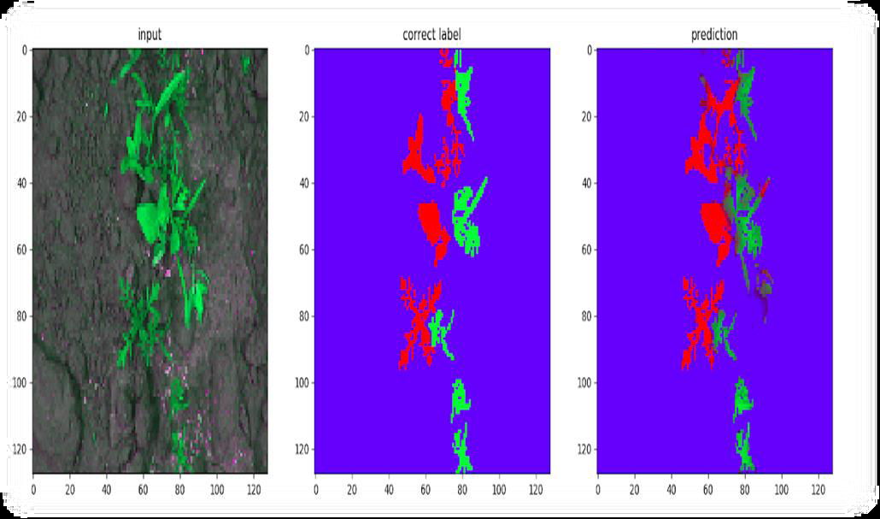
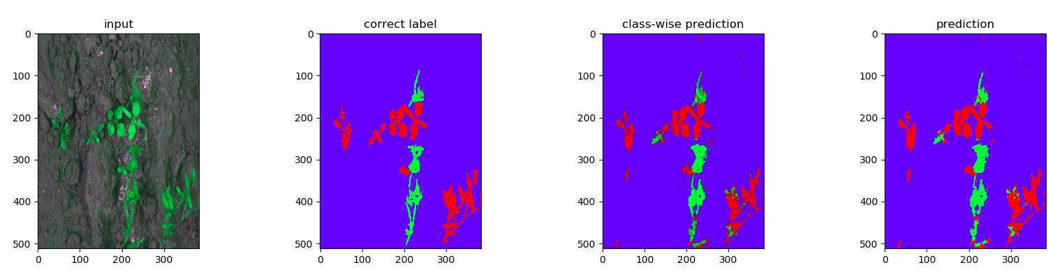
Performance Comparisons on CWFID Dataset
UNet’s prediction
Bonnet’s prediction

Slide 24
Metrics Comparison on CWFID Dataset
Model | Accuracy | Loss
Bonnet | Train: 96.73% Test: 96.48% | Train: 0.01153 units Test: 0.0168 units
UNet | Train: 97.65% Test: 97.20% | Train: 0.0549 units Test: 0.0499 units
Both models were trained and tested on smaller dataset CWFID and their performance were compared. Based on these, final model was selected for further training on larger datasets.
Performance of Bonnet and UNet obtained were similar. Bonnet was selected over Unet due to its better class-wise prediction and 100x lesser parameters than UNet which makes its deployment possible for real-world applications.
Model selected: Bonnet

Slide 25
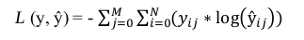
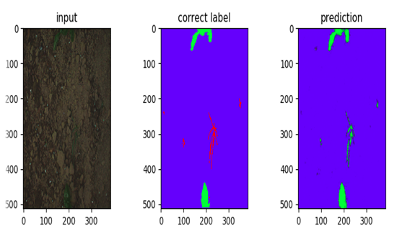
Bonnet’s Performance using different Loss Functions
Categorical cross-entropy:
Here, y is the ground truth & ŷ is the model prediction. It is summed over all pixels in the image and averaged over the entire batch.
Model fails to predict pixels with minor class correctly.
Hence, does not address issue of class imbalance.

Slide 26
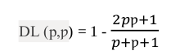
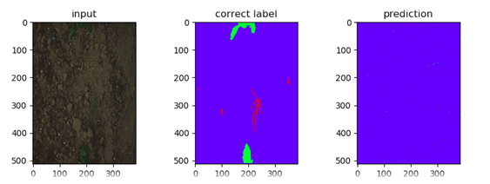
2.) Dice-coefficient Loss:
Here, p is ground truth and ƿ is the prediction. Where p ε {0,1} and 0 ≤ ƿ ≤ 1.
It is a measure of overlap and is a popular loss function in image segmentation tasks.
Due to some unknown reason, model fails to predict classes.

Slide 27
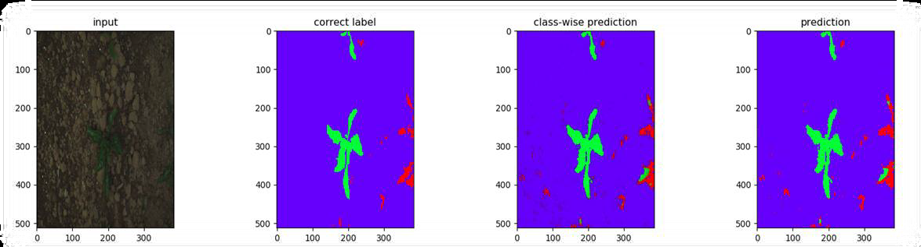
3.) Weighted Cross-entropy Loss (WCCE):
Here, the losses from corresponding classes are weighed in inverse proportion to its frequency of occurrence and summed up across all classes.
class_weights = [0.90,0.11,0.1] in order of Weed,Crop and Soil.(i.e R,G and B).
It counters class imbalance which was caused in case of categorical cross-entropy.
Model trained using WCCE loss performs better than the other losses and its prediction is quite similar to ground truth.
Loss Function used: WCCE

Slide 28
5. Results & Conclusion
Teleoperation
Autonomous Monitoring
Bonnet model Performance

Slide 29
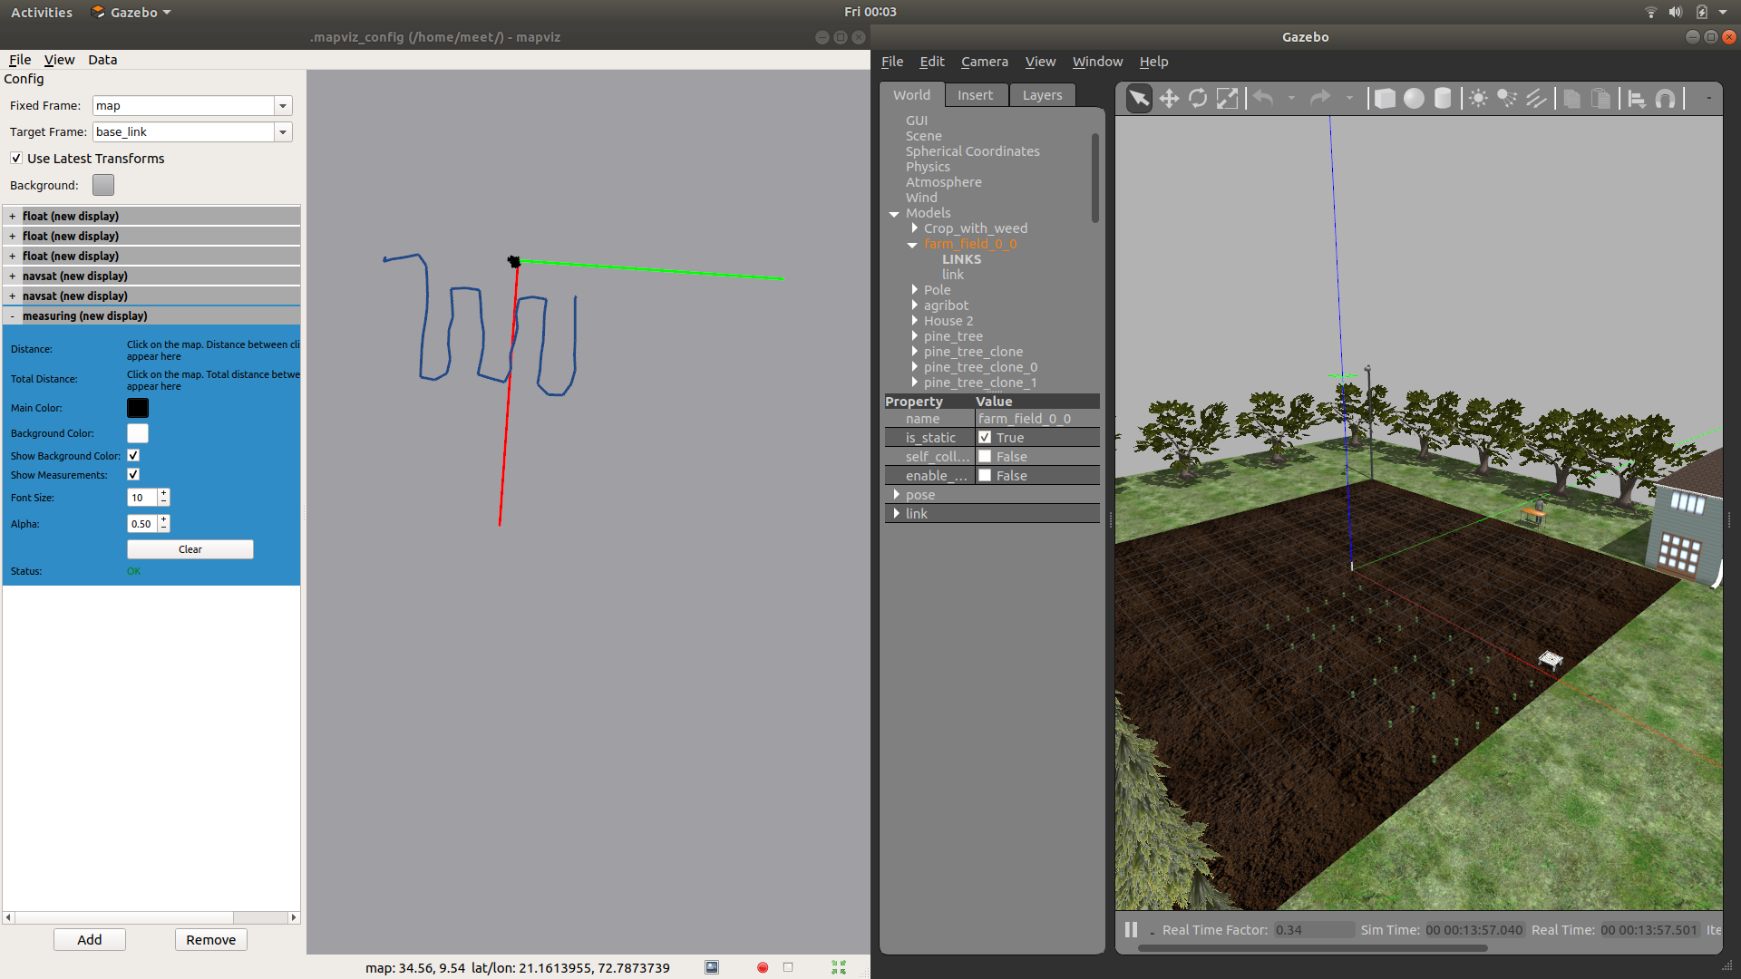
1. Teleoperation

Slide 30
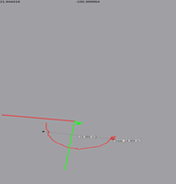
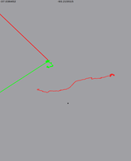
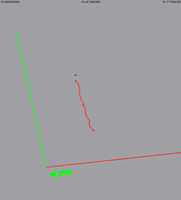
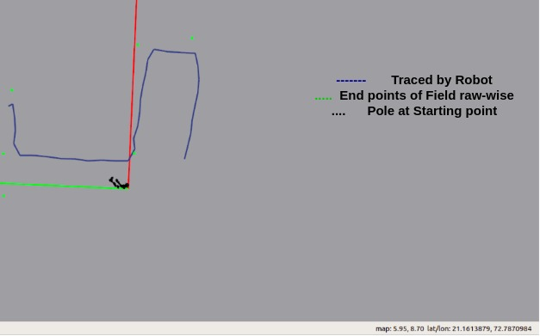
2. Autonomous Monitoring
Testing of Trajectory planner Algorithm(For random points)
Different Points at end of raw in Field

Slide 31
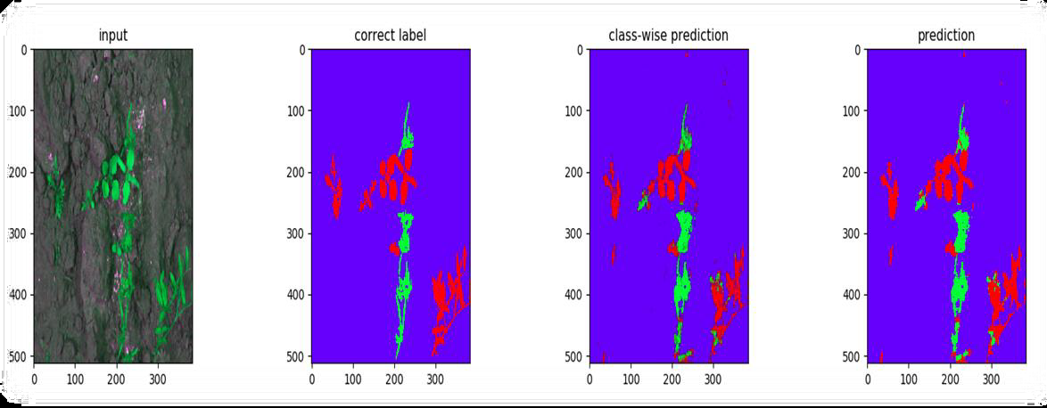
3. Predictions of Classification Model
Bonnet’s prediction on CWFID Dataset.
Bonnet’s prediction on Bonn Dataset.

Slide 32
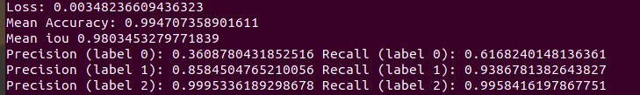
Metrics
Real-time Latency: Avg 2.5 fps on i7 + NVIDIA 940MX

Slide 33
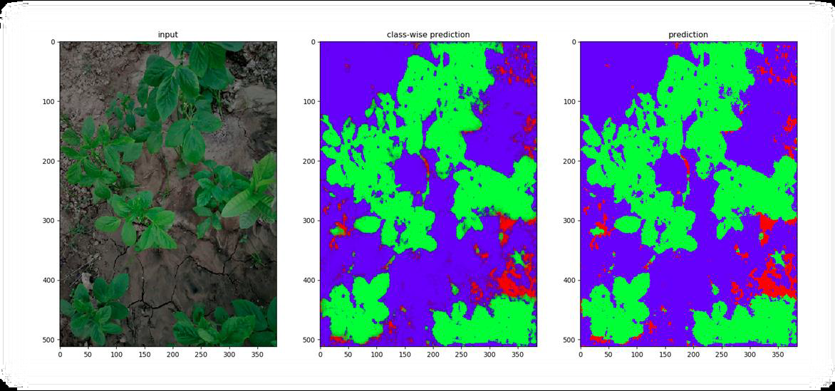
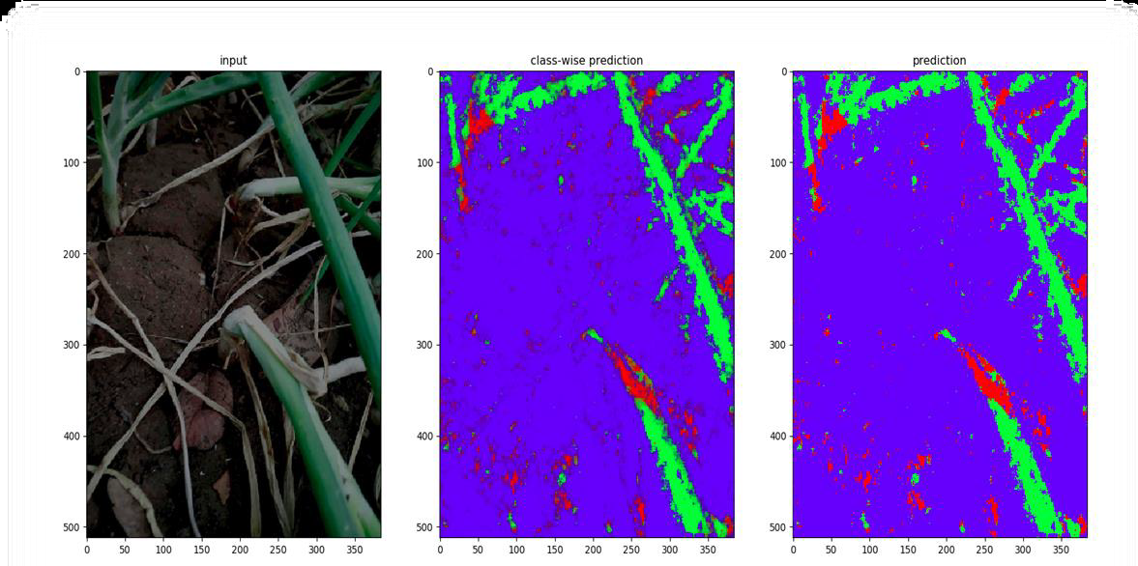
Prediction on images of Surrounding Farm
Continued in the next slide.

Slide 34
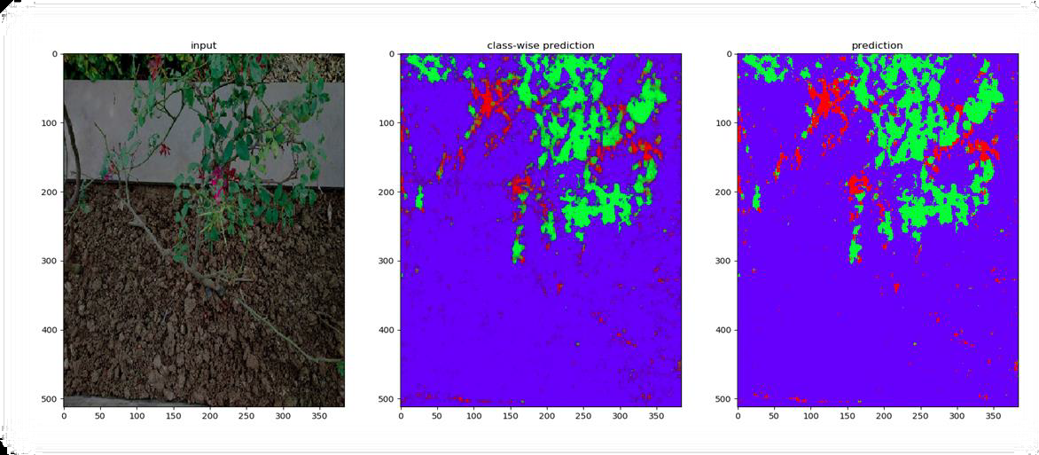
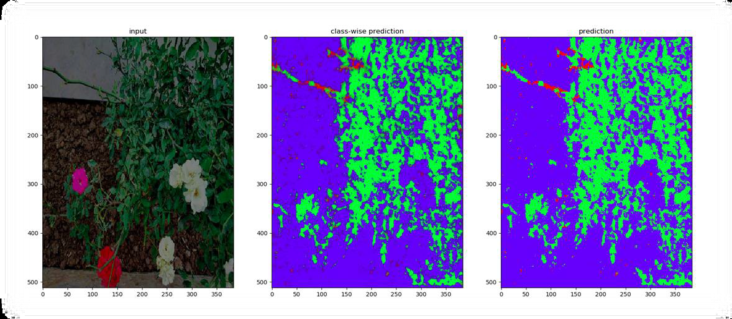

Slide 35
Conclusion
We have modelled and simulated the AGRIBOT and also developed the simulated environment for testing the same. We tested the performance of AGRIBOT with teleoperation and with the algorithms for autonomous navigation. Using Differential GPS and advanced sensor fusion techniques, error can be further reduced to make trajectory more smoother.
Bonnet model: Segments the vegetation mask and has learned to classify less greeny and dry parts of vegetation as weeds. Further improvement can be done by providing data from real-case scenarios/applications where the deployment is to be done.
Real-time latency: avg. 2.5 fps on i7 + NVIDIA 940MX.
Mean accuracy: 99.47%, Mean iou: 98.03%, Loss: 0.00348 units on Bonn dataset.

Slide 36
DEMO

Slide 37
Q&A

Slide 38
THANK YOU.

